Slide 1
Software Engineering
Course Guidelines
Dr. Shai Koenig
Open University
Department of Computer Science
Comverse Office: 03-6452639
Open University Office: 09-???????
Mobile: 052-8542639 [emergencies]
E-mail: shai.koenig@comverse.com

Slide 2
Getting started
Send an email to
  Shai.Koenig@comverse.com
  zelovich@zahav.net.il
  with
  Your name
  ID
  Telephone numbers
  E-mail address
All emails regarding this course should use the string
“OU-22916-2005A-”
as the prefix of the email’s “Subject” field.

Slide 3
Course Organization
Introduction to Software Engineering
Introduction to Software Management
Software Process and Quality Management
Systems Engineering
SW Requirements - Concepts, Principles and Techniques
Software Design - Concepts, Principles and Techniques
Software Testing - Concepts, Principles and Techniques
Software Configuration Management

Slide 4
Course Requirements
Course readings
Course meetings
Course project
Exercises
Final exam

Slide 5
Course Readings
Pressman
Readings in Software Design
ISO 12207 - Software Life Cycle Processes
Lecture Notes – to be posted on University course site

Slide 6
Course Meetings
Participation is encouraged
Review and comment on the module [which you are expected to have completed]
Questions and Discussion
Overview of the next modules
Exercises
Course project

Slide 7
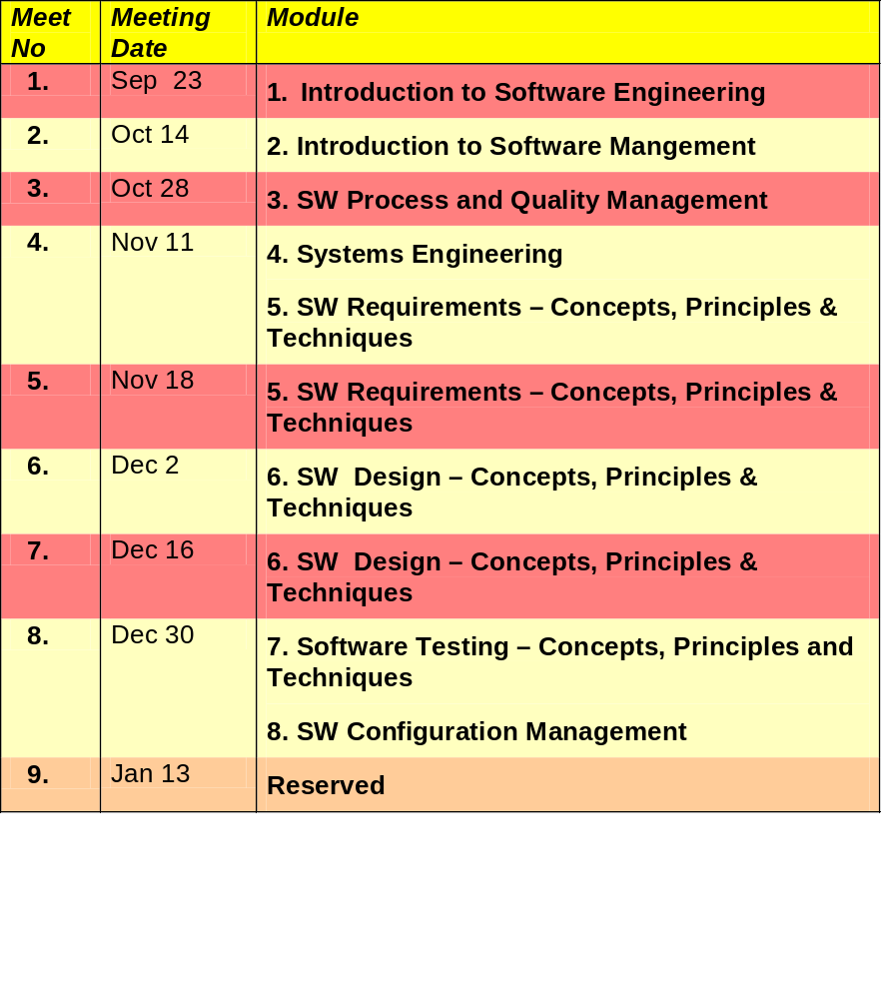
Course Meetings

Slide 8
Course Project
“Real” software process improvement project - Selecting a “real” development technique/tool/process and infusing it into a “real” project or organization, for example
    Requirements management
    Design techniques and/or tools
    Testing processes and/or tools
    Metrics
    Risk management
    Change [defect & feature] management
    Configuration management
A team of 3-4 students build a useful software engineering tool, employing modern software engineering practices.
See chapter 6 the Course Guide for details.
Should be completed by 30 Augut 2005.
Must be completed by 30 October 2005.

Slide 9
Exercises
Submissions: in class or via regular mail. NO EMAIL SUBMISSIONS!
Submit to Izik Zelovich
    03-9226317
    054-303188
Telephone hours:
    Mon 19:00-20:00
    Wed 19:00-20:00
Mail:
    Izik Zelovich
    Rechov Pika 20
    Petach Tikva 49611
Email
    zelovich@zahav.net.il
Exercises must be submitted on time. They will not be accepted when more than 10 days late.

Slide 10
Course Grading
10% - Exercises
50% - Course Project
40% - Final Exam

Slide 11
Instructor Contact Details
Email
    shai.koenig@comverse.com
Phone
    03-6452639 [Comverse Office]
    09-??????? [ Open U office]
    058-542639 [emergency]
Telephone hours:
    Wed 18:00-19:00
Mail:
    Comverse
    Habarzel 29
    Tel Aviv 69710

Slide 12
Student Questionnaire
To be filled out and submitted.

